Slide 1

CalorieMate
By Team 3 - The Innovators

Slide 2
Agenda
Agenda
Team Member Roles and Responsibilities
Improvements from Professor Feedback
Project Description
Team Working Agreement
Personas
MVP
Technologies
Algorithms
Diagrams
Product Backlog
Sprint 1 Backlog
Metrics
Retrospective
Sprint 2
Project Demo - Sprint 1
GitHub Link
Live Application Demo

Slide 3
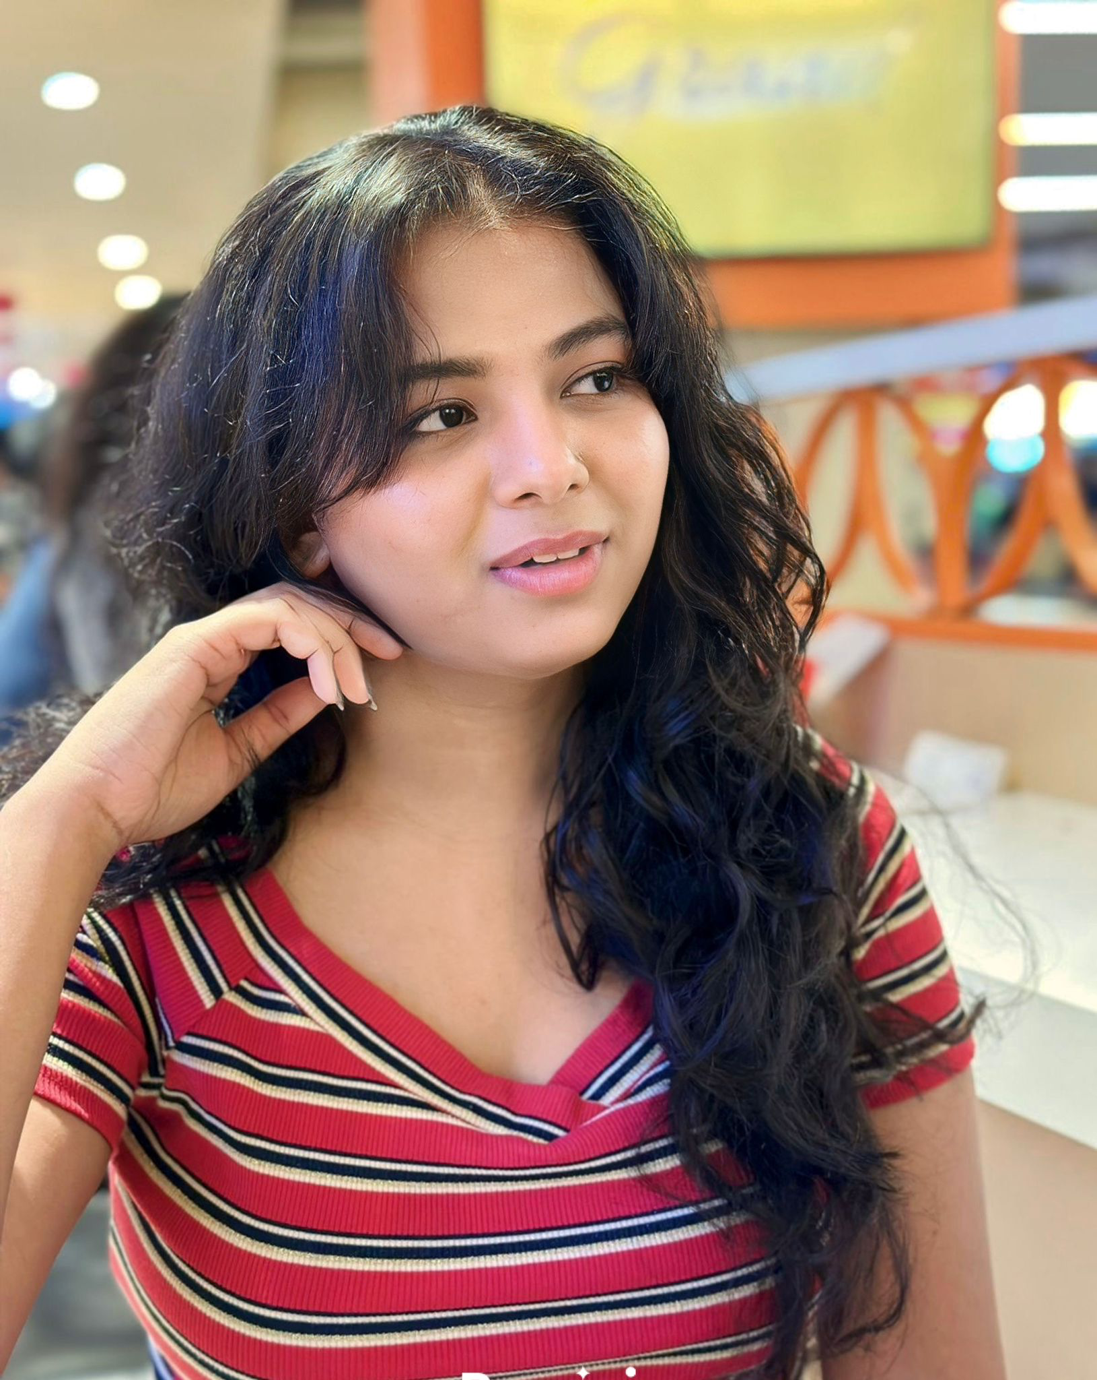


Team Member Roles and Responsibilities
Ranjitha Durgasi – Frontend Developer- Team Leader
Nikhitha Reddy Nallanagula – Frontend Developer
Harshitha Korapati Murali – Backend Developer

Slide 4

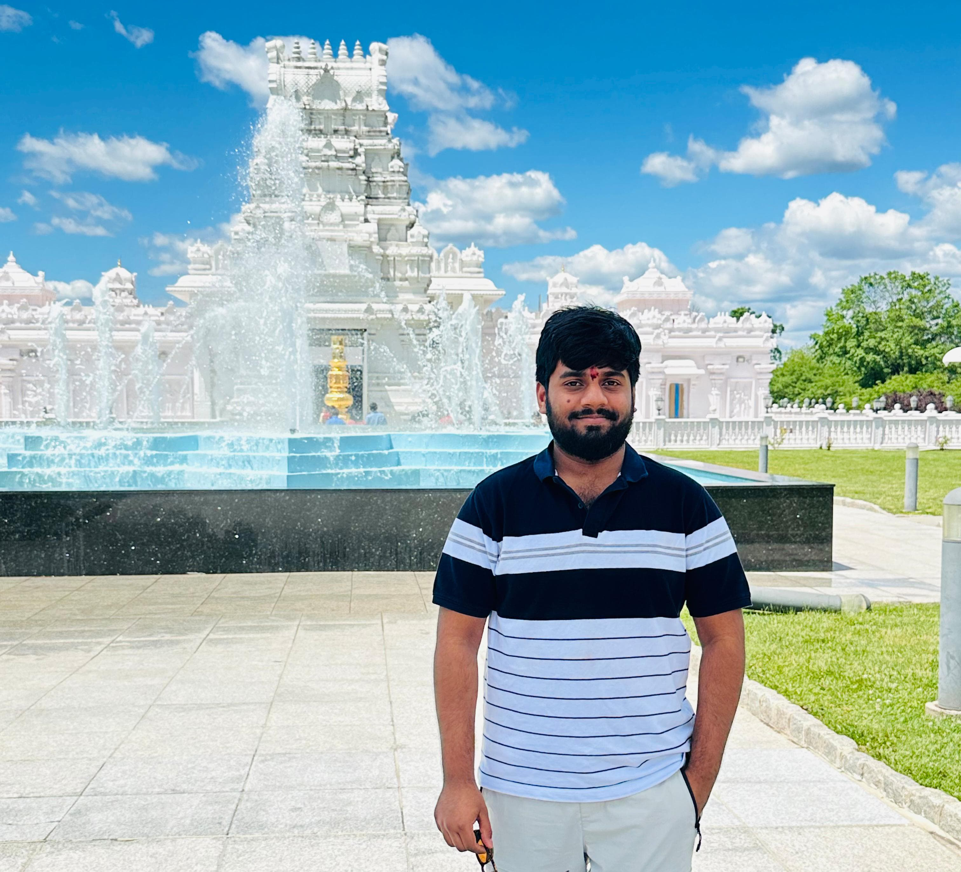
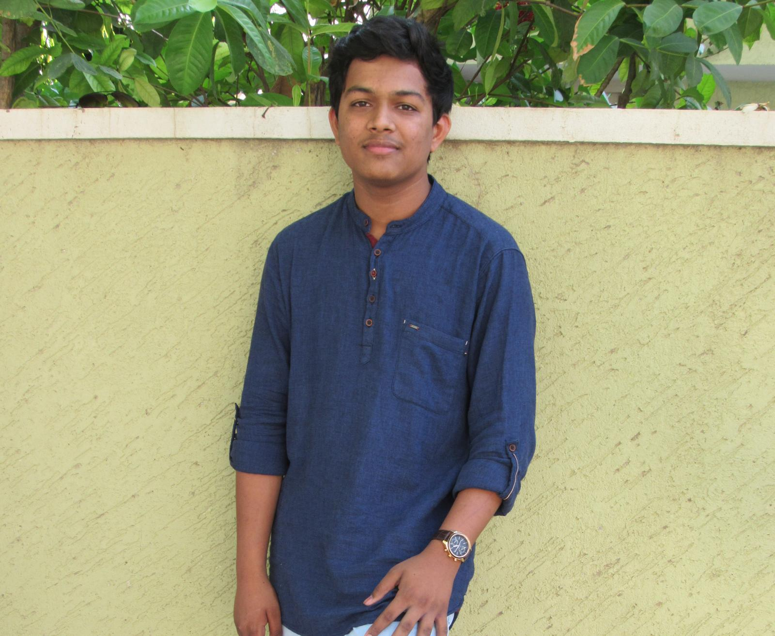
Team Member Roles and Responsibilities
Sai Bhargav Ram Koduru – Backend Developer
Saikumar Gone – Machine Learning Engineer- Scrum Master
Kariveda Vikranth Reddy – Machine Learning Engineer

Slide 5
Improvements
Showing the working agreement by the team.

Slide 6
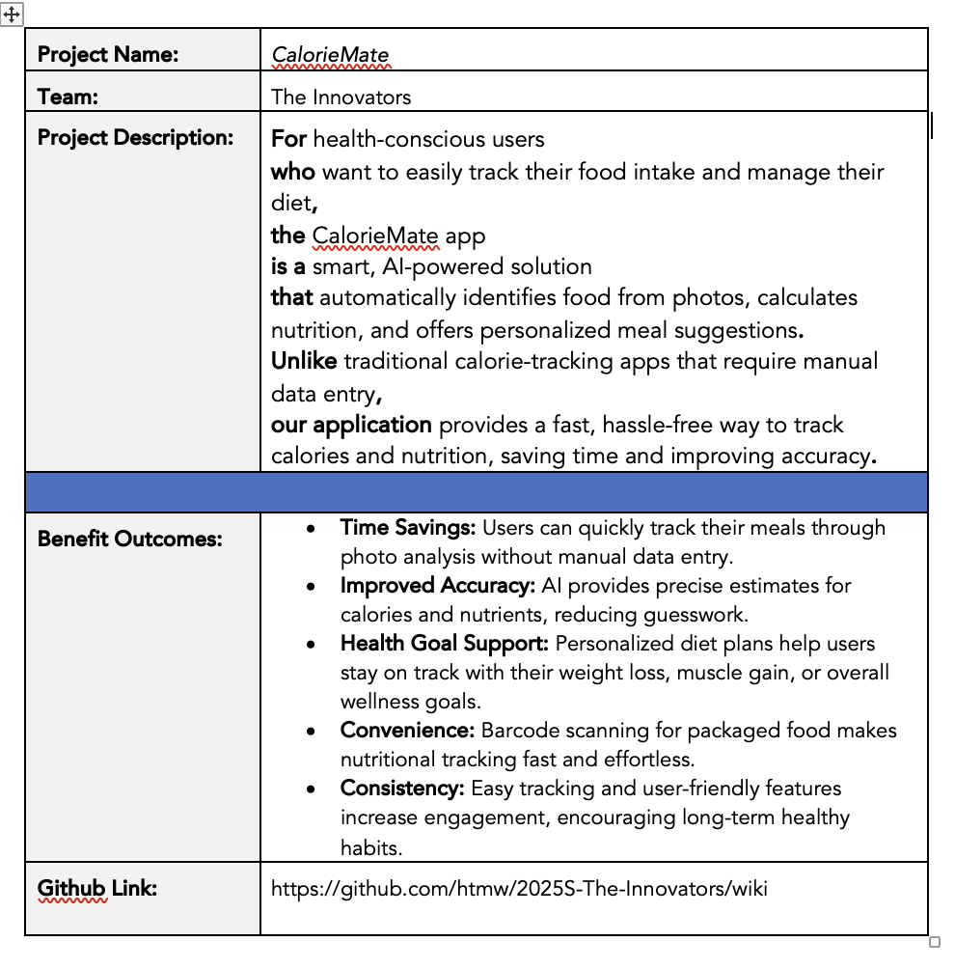
Project Description

Slide 7
Team Working Agreement
Communication: Lets make sure to share updates and have discussions on platforms like Slack. Make sure to have check ins, such, as weekly stand up meetings or sprint reviews to keep everyone on the same page and working together smoothly. Cooperation;
Team Meetings & Collaboration: To ensure effective meetings, the team should agree on key points, such as scheduling regular meetings twice a week at 6-8pm via virtual (zoom).Our main agenda is to make all team members work and make submissions on time. As a team we should help one another by sharing each other thoughts and make sure all perspectives are heard before deciding.
Roles and Responsibilities: Each team member has the task of finishing assignments based on their designated roles in frontend development, backend development, and machine learning. Coordinate with teams to seamlessly incorporate various functionalities.
Decision-Making: Decisions will be collaboratively reached in team gatherings. In situations where there are differences in opinions or views arise among us team members, we go for majority votes.
Deliverables: Each sprint should lead to producing the outcomes like presentations updates, to technical papers and wikis. Make sure to review and test all your work before submitting it for consideration.
Retrospectives: After each sprint is completed it's important to have a session to review the successes and areas for improvement as well as to outline specific steps, for the upcoming sprint.
Agreed by:
Ranjitha Durgasi
Nikhitha Reddy Nallanagula
Harshitha Korapati Murali
Sai Bhargav Ram Koduru
Saikumar Gone
Kariveda Vikranth Reddy

Slide 8
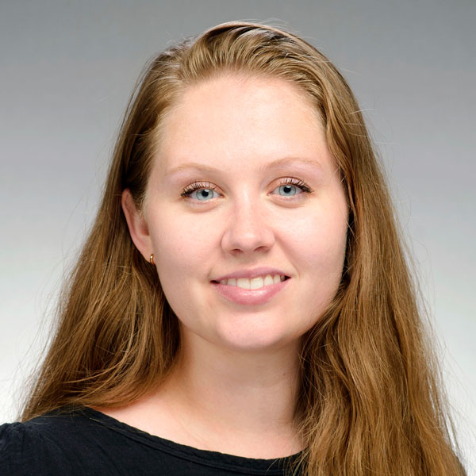
Persona
Emma Johnson (Fitness Freak)
Age: 28
Occupation: Marketing Specialist
Goals: To build muscle and maintain a healthy diet.
Challenges: Finds it time-consuming to manually log every meal and calculate macros (proteins, carbs, fats).
How CalorieMate Helps: Emily can take photos of her meals to instantly track nutrients, saving time and keeping her fitness plan on track.

Slide 9

Persona
John Cook (Busy Professional)
Age: 35
Occupation: Software Engineer
Goals: To lose weight and adopt healthier eating habits.
Challenges: Limited time to research or record calorie information due to his demanding work schedule.
How CalorieMate Helps: The app’s photo recognition and barcode scanner allow John to quickly track meals, making calorie management fit seamlessly into his day.

Slide 10

Persona
Kruti Patel (Health-Conscious Parent)
Age: 42
Occupation: Teacher
Goals: To maintain a balanced diet and teach her family healthy eating habits.
Challenges: Difficulties estimating nutritional content of home-cooked meals.
How CalorieMate Helps: Kruti can easily track home-cooked meals using photo recognition and adjust portions to get accurate nutritional insights, helping her plan meals for the entire family.

Slide 11
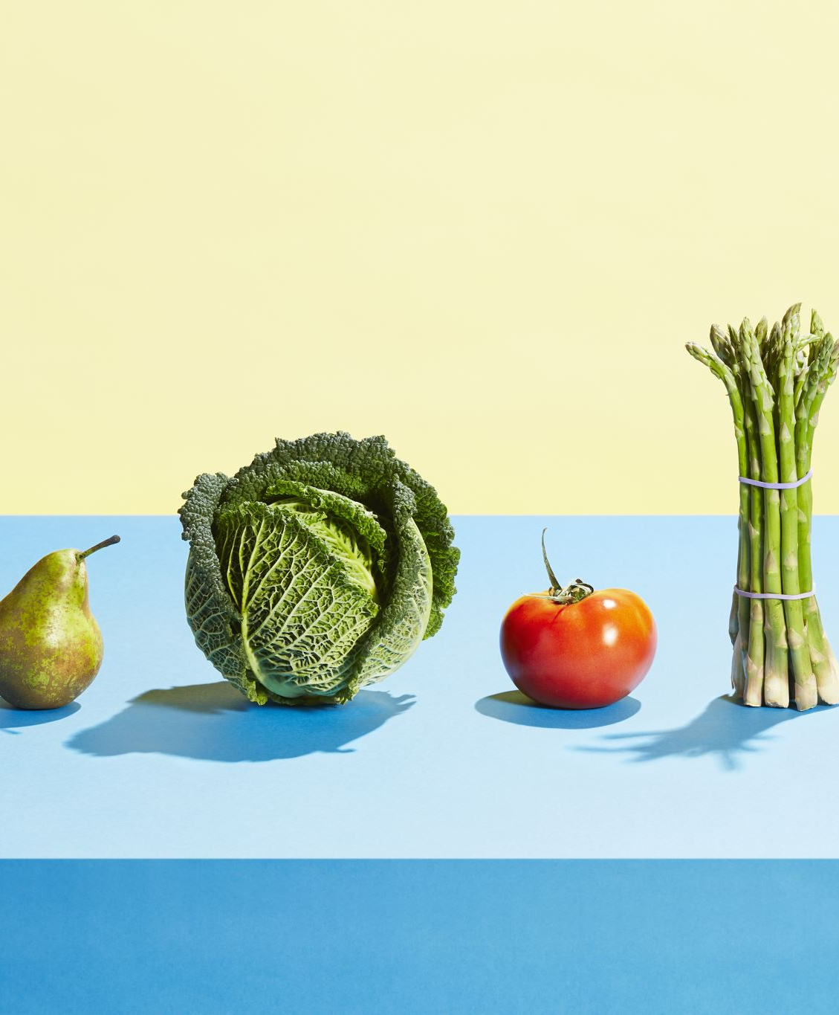
MVP
Food identification from photos using AI
Automatic calorie and nutrition calculation
Barcode scanning for packaged food
Daily calorie and nutrient tracking dashboard
Personalized meal suggestions based on user goals

Slide 12

Technologies
Frontend: Expo (React Native)
Used to build the mobile app for both Android and iOS platforms, ensuring a smooth and consistent user experience across devices.

Slide 13



Technologies
Backend: FastAPI, MongoDB, AWS
FastAPI: Manages API communication between the mobile app, machine learning models, and database.
MongoDB: Stores user data such as meals, nutritional logs, and preferences.
AWS: Provides cloud infrastructure for hosting the app, including APIs, databases, and machine learning services, ensuring scalability and reliability.

Slide 14


Technologies
Machine Learning: PyTorch, Hugging Face
PyTorch: Used to build and deploy AI models for food recognition and nutrition estimation.
Hugging Face: Supplies pre-trained vision-language models (VLM) to improve image recognition accuracy, reducing development time.

Slide 15
Algorithm
Our application utilizes some important algorithms to automate and enhance the process of calorie and nutrition tracking. The food image recognition algorithm employs the InstructBLIP model to process meal images, identify food items, and recognize them with high accuracy. After recognizing the foods, a nutritional estimation algorithm estimates the calories, proteins, carbohydrates, and fats based on nutritional databases and approximate portion sizes.

Slide 16
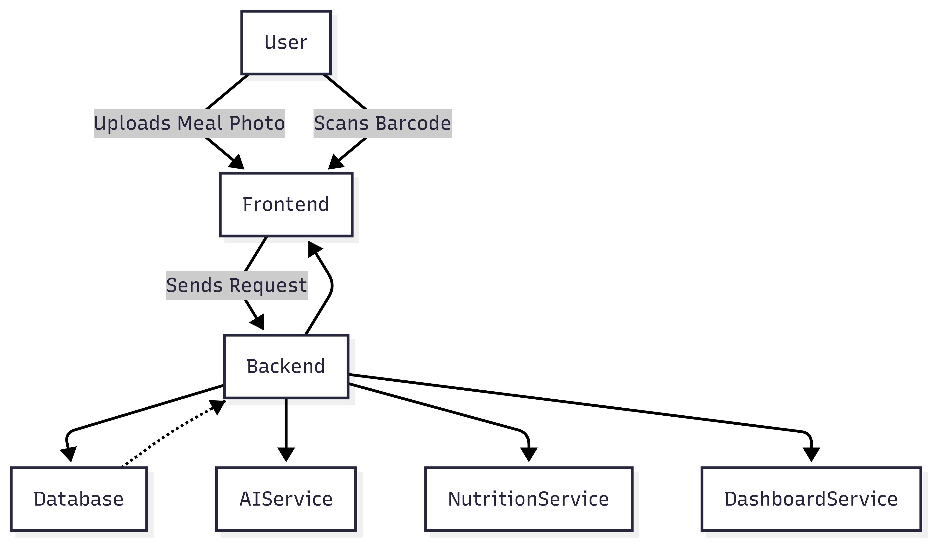
Architecture Diagram

Slide 17
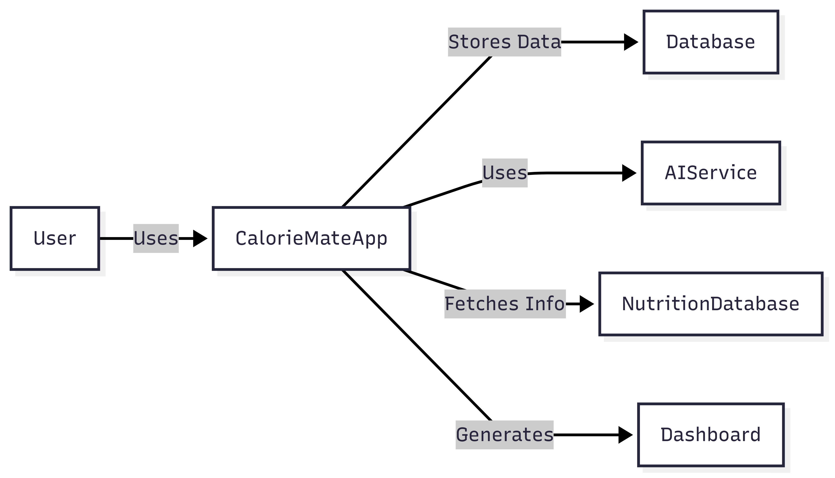
Context diagram

Slide 18
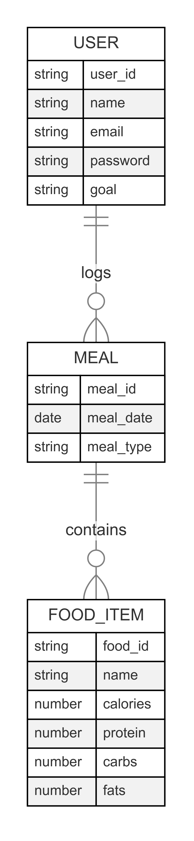
ER Diagram

Slide 19
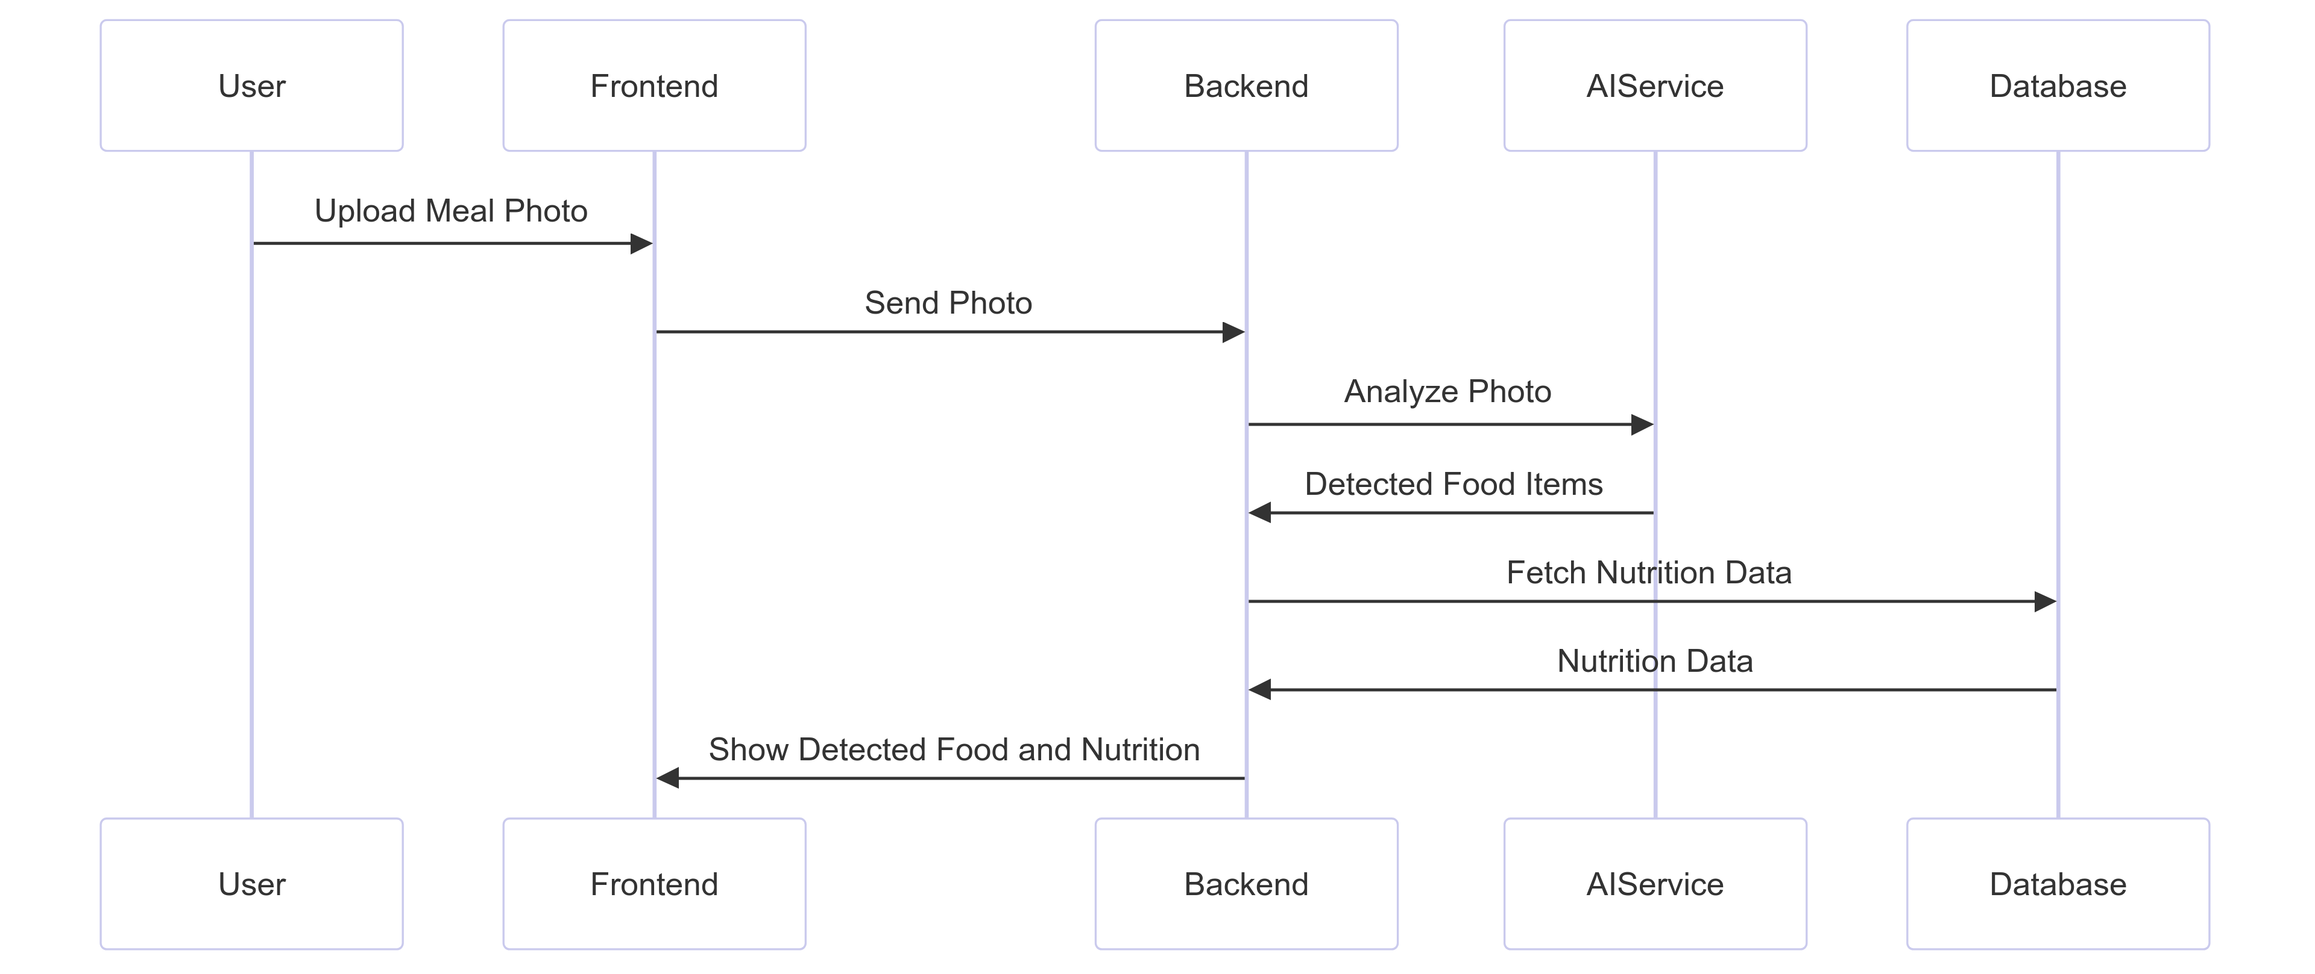
Sequence Diagram

Slide 20
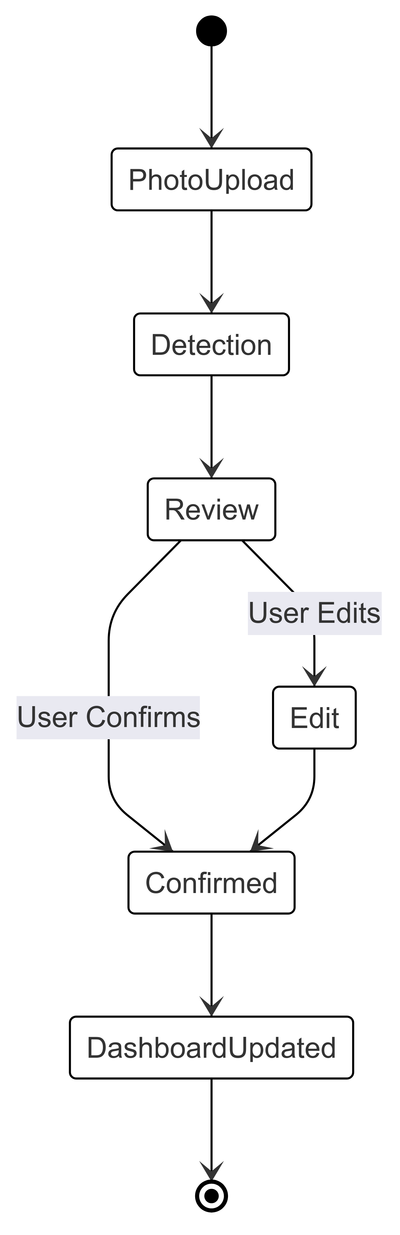
State Diagram

Slide 21
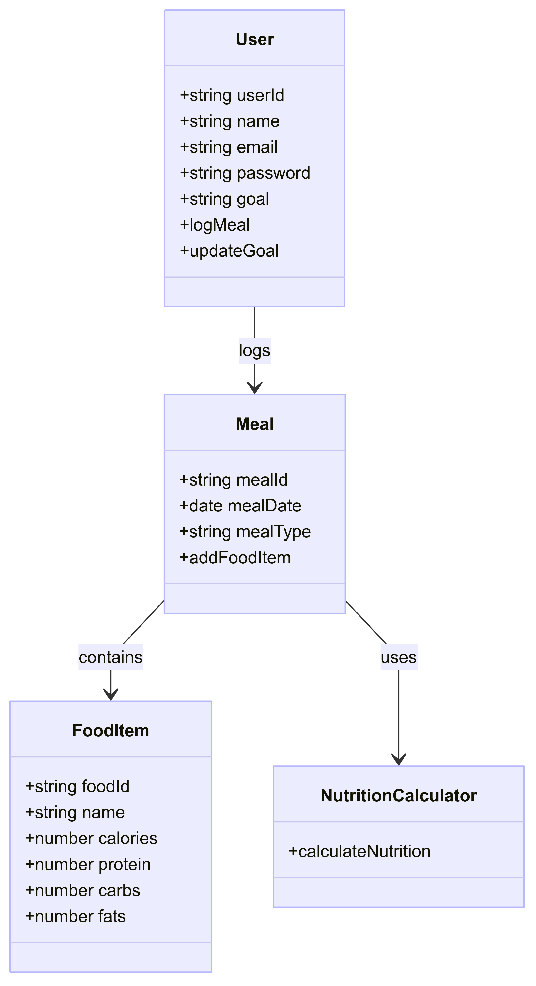
Class Diagram

Slide 22
Product Backlog
ID | User Stories | Acceptance Criteria | Feature | Story Points | Sprint
US1 | As a user, I want to create an account and log in so that my data is saved. | User can sign up and log in Error shown for wrong credentials Logout works | Authentication | 3 | 1
US2 | As a user, I want to upload a meal photo or take an image from the camera so that I can manually enter my food details. | Users can upload an image or take a photo. Users manually input food items. Error shown if no items are added. | Photo Upload | 5 | 1
US3 | As a user, I want to manually enter food items so that I can track my meals. | Users can enter food items manually. Users can input portion sizes. Data is saved to the meal log after confirmation. | Food Entry | 3 | 1
US4 | As a user, I want to edit food items so that my meal log is accurate. | Users can modify the food name and portion size. Changes are saved automatically to the meal log. | Manual Food Editing | 3 | 1
US5 | As a user, I want to see a daily dashboard so that I can track my calories and nutrients. | Dashboard shows calories consumed, remaining budget Macro breakdown shown | Dashboard | 3 | 1

Slide 23
Product Backlog
ID | User Stories | Acceptance Criteria | Feature | Story Points | Sprint
TS1 | Set up user authentication backend | Database created for users Signup, login, logout APIs ready Passwords securely stored | Authentication Backend | 3 | 1
TS2 | Set up photo upload UI | Users can upload images from the gallery or take a photo. | Photo Upload | 5 | 1
TS3 | Build UI for manual food entry | Users can enter food names and portion sizes manually. | Food Entry | 3 | 1
TS4 | Build UI for food editing | Users can edit food items and portion sizes. | Manual Food Editing | 3 | 1
TS5 | Build daily dashboard UI & backend | Dashboard reads meal log Calculates totals Shows simple charts | Dashboard Backend + UI | 3 | 1

Slide 24
Product Backlog
ID | User Stories | Acceptance Criteria | Feature | Story Points | Sprint
US6 | As a user, I want to scan barcodes to log packaged food so that I can log faster. | Barcode scanning works Finds product in database Adds to meal log | Barcode Scanning | 5 | 2
US7 | As a user, I want to set my health goal so that my calorie target is personalized. | Goal can be set Calorie target updates Goal can be changed later | Goal Setting | 2 | 2
US8 | As a user, I want to see my daily macro breakdown so that I know if my meals are balanced. | Dashboard shows grams & percentages for macros Updates after each meal log | Dashboard | 2 | 2
US9 | As a user, I want to edit or delete past meal entries so that I can fix mistakes. | Past meals listed Edit or delete works Dashboard recalculates after change | Meal Log Management | 3 | 2
US10 | As a user, I want to view my full meal history so that I can review my past eating habits. | All past meals listed by date Clicking shows full details | Meal History | 2 | 2

Slide 25
Product Backlog
ID | User Stories | Acceptance Criteria | Feature | Story Points | Sprint
TS6 | Build barcode scanning backend and food database | Food database includes packaged foods Barcode scanning works on mobile Adds directly to log | Barcode Scanner Backend | 5 | 2
TS7 | Set up goal setting feature | Goal stored in user profile Goal adjusts calorie target in dashboard | Goal Backend | 2 | 2
TS8 | Add macro breakdown logic to dashboard | Dashboard calculates macros from meals Updates automatically | Dashboard Logic | 2 | 2
TS9 | Build meal history with edit/delete | Meal logs stored by date Edit and delete APIs work Dashboard updates after changes | Meal Log Backend | 3 | 2
TS10 | Build full meal history page | Meals listed by date Clicking opens meal details | Meal History UI | 2 | 2

Slide 26
Product Backlog
ID | User Stories | Acceptance Criteria | Feature | Story Points | Sprint
US11 | As a user, I want to see calories and nutrients after entering my meal so that I know what I’m eating. | Users enter food items manually. Calories, protein, carbs, and fats are displayed. Data is saved to the meal log. | Calorie & Nutrition Display | 5 | 3
US12 | As a user, I want to see a weekly progress report so that I can track my long-term trends. | Weekly calories graph shown Weekly macro average shown | Progress Report | 3 | 3
US13 | As a user, I want a settings page to manage my preferences so that I can customize the app. | User can set units (metric/imperial) User can change goal Changes saved immediately | Settings | 2 | 3
TS11 | Build AI-based calorie & nutrition calculation | Users enter food items manually. AI calculates calories, protein, carbs, and fats. Data is saved to the meal log. | AI-Based Nutrition Calculation | 5 | 3
TS12 | Build weekly progress backend & UI | Backend calculates 7-day summary UI shows graph & macro summary | Progress Report | 3 | 3

Slide 27
Product Backlog
ID | User Stories | Acceptance Criteria | Feature | Story Points | Sprint
TS13 | Build settings page backend & UI | Preferences saved per user Changes reflected in dashboard Supports units and goals | Settings Backend + UI | 2 | 3

Slide 28
Sprint 1 Backlog
ID | User Stories | Acceptance Criteria | Feature | Story Points | Sprint
US1 | As a user, I want to create an account and log in so that my data is saved. | User can sign up and log in Error shown for wrong credentials Logout works | Authentication | 3 | 1
US2 | As a user, I want to upload a meal photo or take an image from the camera so that I can manually enter my food details. | Users can upload an image or take a photo. Users manually input food items. Error shown if no items are added. | Photo Upload | 5 | 1
US3 | As a user, I want to manually enter food items so that I can track my meals. | Users can enter food items manually. Users can input portion sizes. Data is saved to the meal log after confirmation. | Food Entry | 3 | 1
US4 | As a user, I want to edit food items so that my meal log is accurate. | Users can modify the food name and portion size. Changes are saved automatically to the meal log. | Manual Food Editing | 3 | 1
US5 | As a user, I want to see a daily dashboard so that I can track my calories and nutrients. | Dashboard shows calories consumed, remaining budget Macro breakdown shown | Dashboard | 3 | 1

Slide 29
Sprint 1 Backlog
ID | User Stories | Acceptance Criteria | Feature | Story Points | Sprint
TS1 | Set up user authentication backend | Database created for users Signup, login, logout APIs ready Passwords securely stored | Authentication Backend | 3 | 1
TS2 | Set up photo upload UI | Users can upload images from the gallery or take a photo. | Photo Upload | 5 | 1
TS3 | Build UI for manual food entry | Users can enter food names and portion sizes manually. | Food Entry | 3 | 1
TS4 | Build UI for food editing | Users can edit food items and portion sizes. | Manual Food Editing | 3 | 1
TS5 | Build daily dashboard UI & backend | Dashboard reads meal log Calculates totals Shows simple charts | Dashboard Backend + UI | 3 | 1

Slide 30
Test Cases
ID | Test Case Description | Steps to Execute | Expected Result
TC1 | Verify user can successfully sign up | 1. Open app 2. Go to Sign Up page 3. Enter valid email/password 4. Click Sign Up | User account is created and user is redirected to dashboard
TC2 | Verify user can log in with valid credentials | 1. Open app 2. Go to Login page 3. Enter correct email/password 4. Click Login | User logs in and sees dashboard
TC3 | Verify error on invalid login | 1. Open app 2. Enter wrong credentials 3. Click Login | Error message shown
TC4 | Verify meal photo upload works | 1. Go to meal log page 2. Upload meal photo 3. Confirm upload | Photo uploads successfully, user can manually enter food details
TC5 | Verify user can manually enter food details | 1. Upload meal photo 2. Add food item manually 3. Enter portion size 4. Save entry | Food entry is saved in meal log
TC6 | Verify manual food editing works | 1. Open meal log 2. Select a food entry 3. Edit food name or portion size 4. Save changes | Changes are saved, updated food details displayed
TC7 | Verify daily dashboard displays logged meals | 1. Log multiple meals manually 2. Go to dashboard | Dashboard displays list of logged meals
TC8 | Verify logout works | 1. Go to settings 2. Click logout | User is logged out and redirected to login screen

Slide 31
Completed Stories Sprint 1
ID | Story Description
US1 | User account creation and login
US2 | Meal photo upload and manual food entry
US3 | Calorie & nutrition display after manual entry (AI-based in Sprint 3)
US4 | Manual food editing
US5 | Daily dashboard displaying logged meals
TS1 | Backend for user authentication
TS2 | UI for photo upload and manual food entry
TS3 | AI-based nutrition calculator (Sprint 3)
TS4 | UI logic for manual food edit and override
TS5 | Daily dashboard backend and UI

Slide 32
Team Velocity
Team Velocity: 34 story points
All committed stories (34 points) were completed successfully.

Slide 33
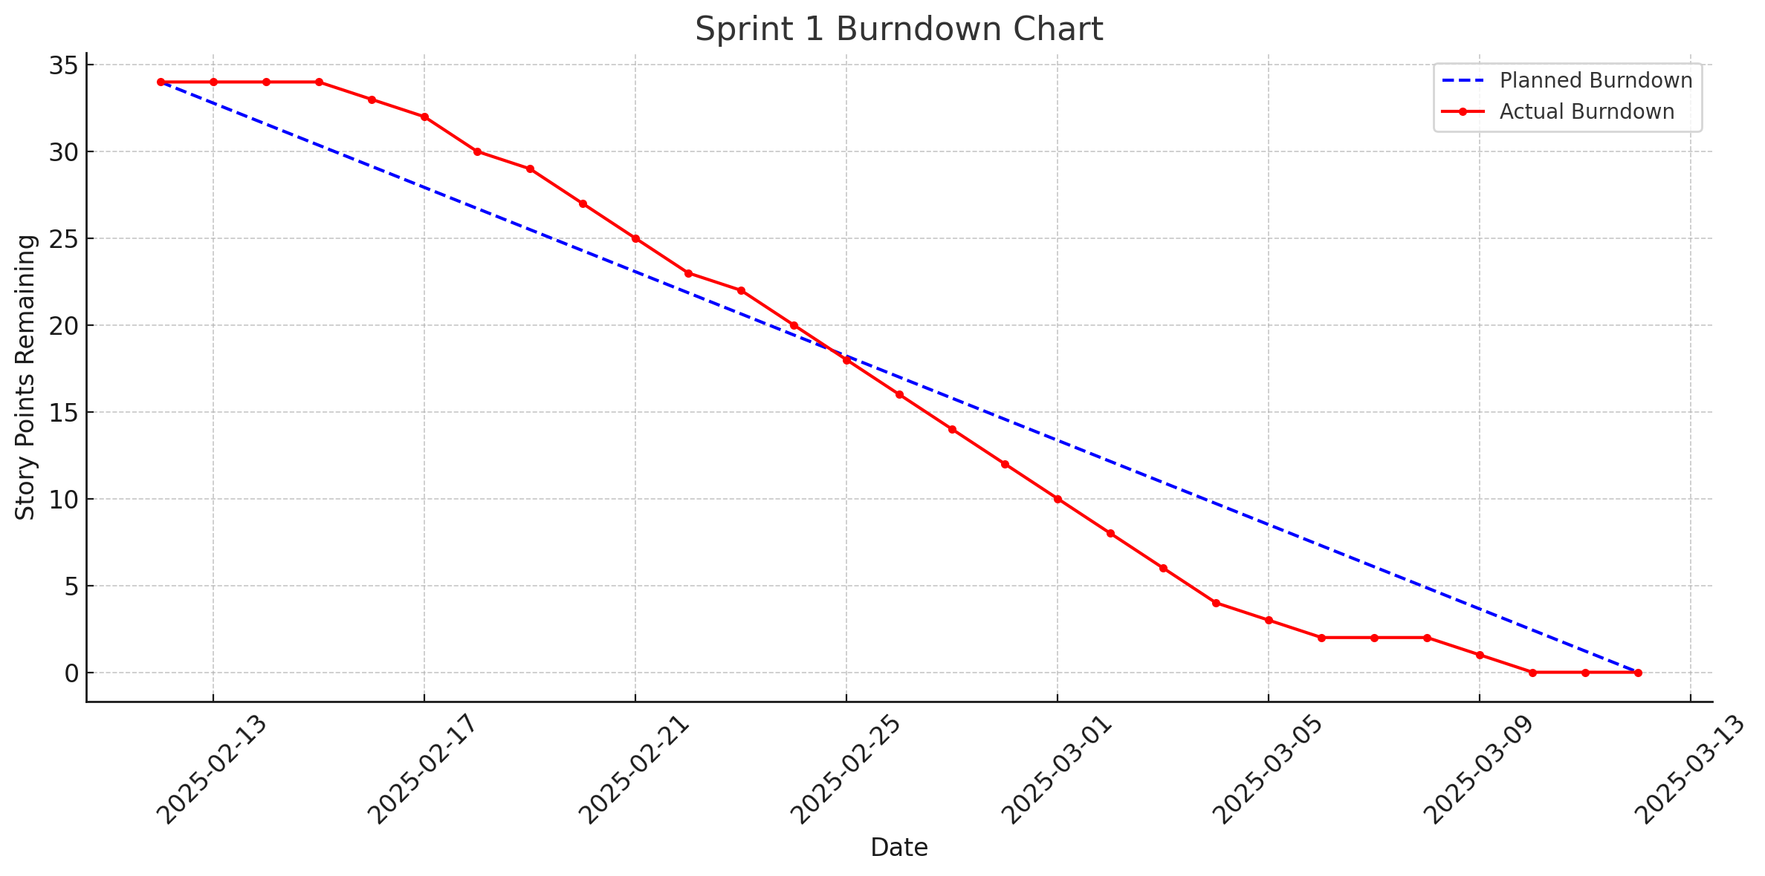
Burndown Chart

Slide 34
Completed/Committed Ratio
Committed: 34 story points
Completed: 34 story points
Completed/Committed Ratio: 34/34 = 100%

Slide 35
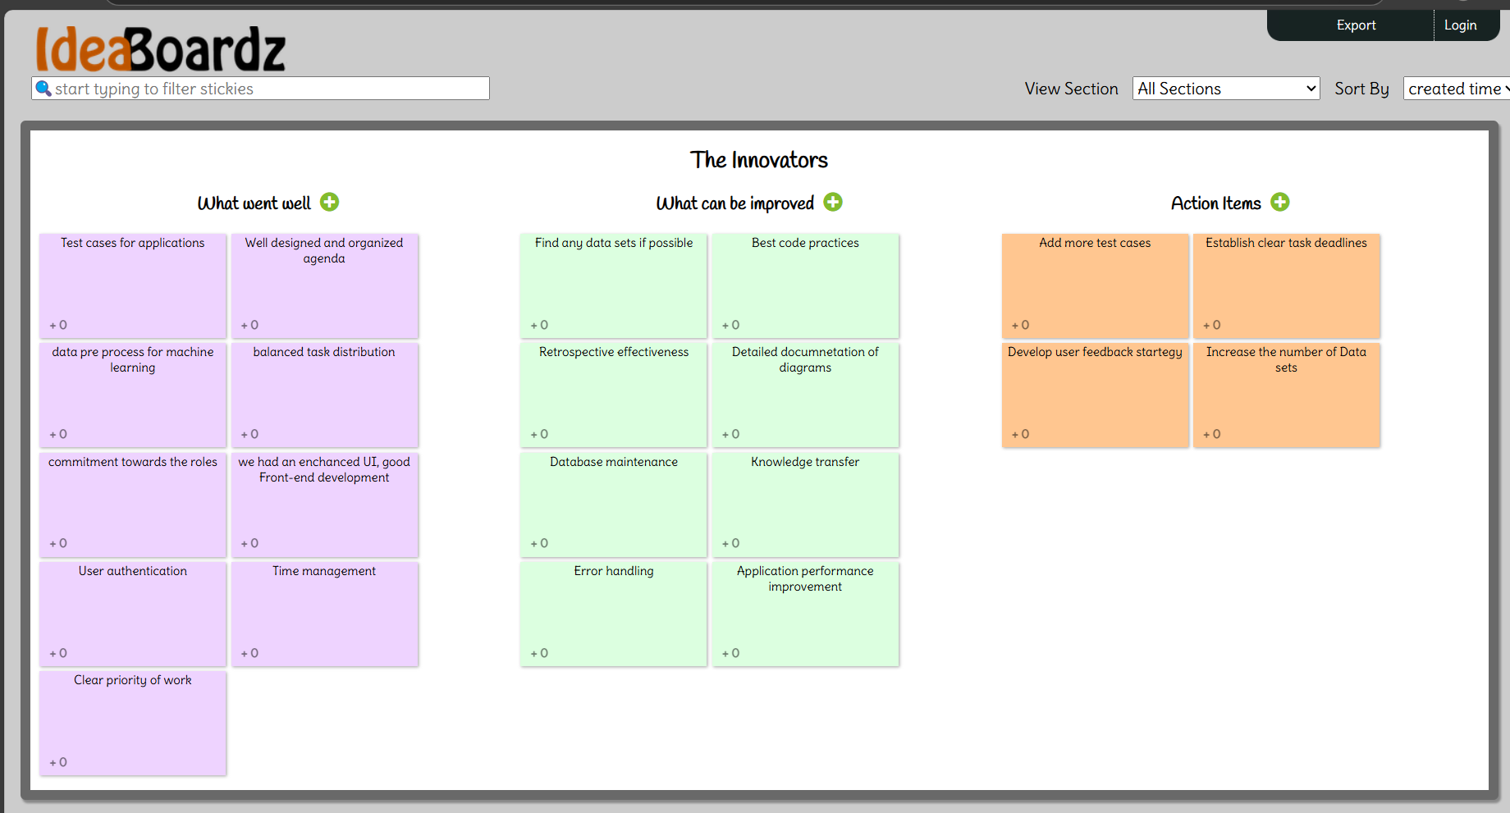
Retrospective

Slide 36
Sprint 2 Planning
ID | User Stories | Acceptance Criteria | Feature | Story Points | Sprint
US6 | As a user, I want to scan barcodes to log packaged food so that I can log faster. | Barcode scanning works Finds product in database Adds to meal log | Barcode Scanning | 5 | 2
US7 | As a user, I want to set my health goal so that my calorie target is personalized. | Goal can be set Calorie target updates Goal can be changed later | Goal Setting | 2 | 2
US8 | As a user, I want to see my daily macro breakdown so that I know if my meals are balanced. | Dashboard shows grams & percentages for macros Updates after each meal log | Dashboard | 2 | 2
US9 | As a user, I want to edit or delete past meal entries so that I can fix mistakes. | Past meals listed Edit or delete works Dashboard recalculates after change | Meal Log Management | 3 | 2
US10 | As a user, I want to view my full meal history so that I can review my past eating habits. | All past meals listed by date Clicking shows full details | Meal History | 2 | 2

Slide 37
Sprint 2 Planning
ID | User Stories | Acceptance Criteria | Feature | Story Points | Sprint
TS6 | Build barcode scanning backend and food database | Food database includes packaged foods Barcode scanning works on mobile Adds directly to log | Barcode Scanner Backend | 5 | 2
TS7 | Set up goal setting feature | Goal stored in user profile Goal adjusts calorie target in dashboard | Goal Backend | 2 | 2
TS8 | Add macro breakdown logic to dashboard | Dashboard calculates macros from meals Updates automatically | Dashboard Logic | 2 | 2
TS9 | Build meal history with edit/delete | Meal logs stored by date Edit and delete APIs work Dashboard updates after changes | Meal Log Backend | 3 | 2
TS10 | Build full meal history page | Meals listed by date Clicking opens meal details | Meal History UI | 2 | 2

Slide 38
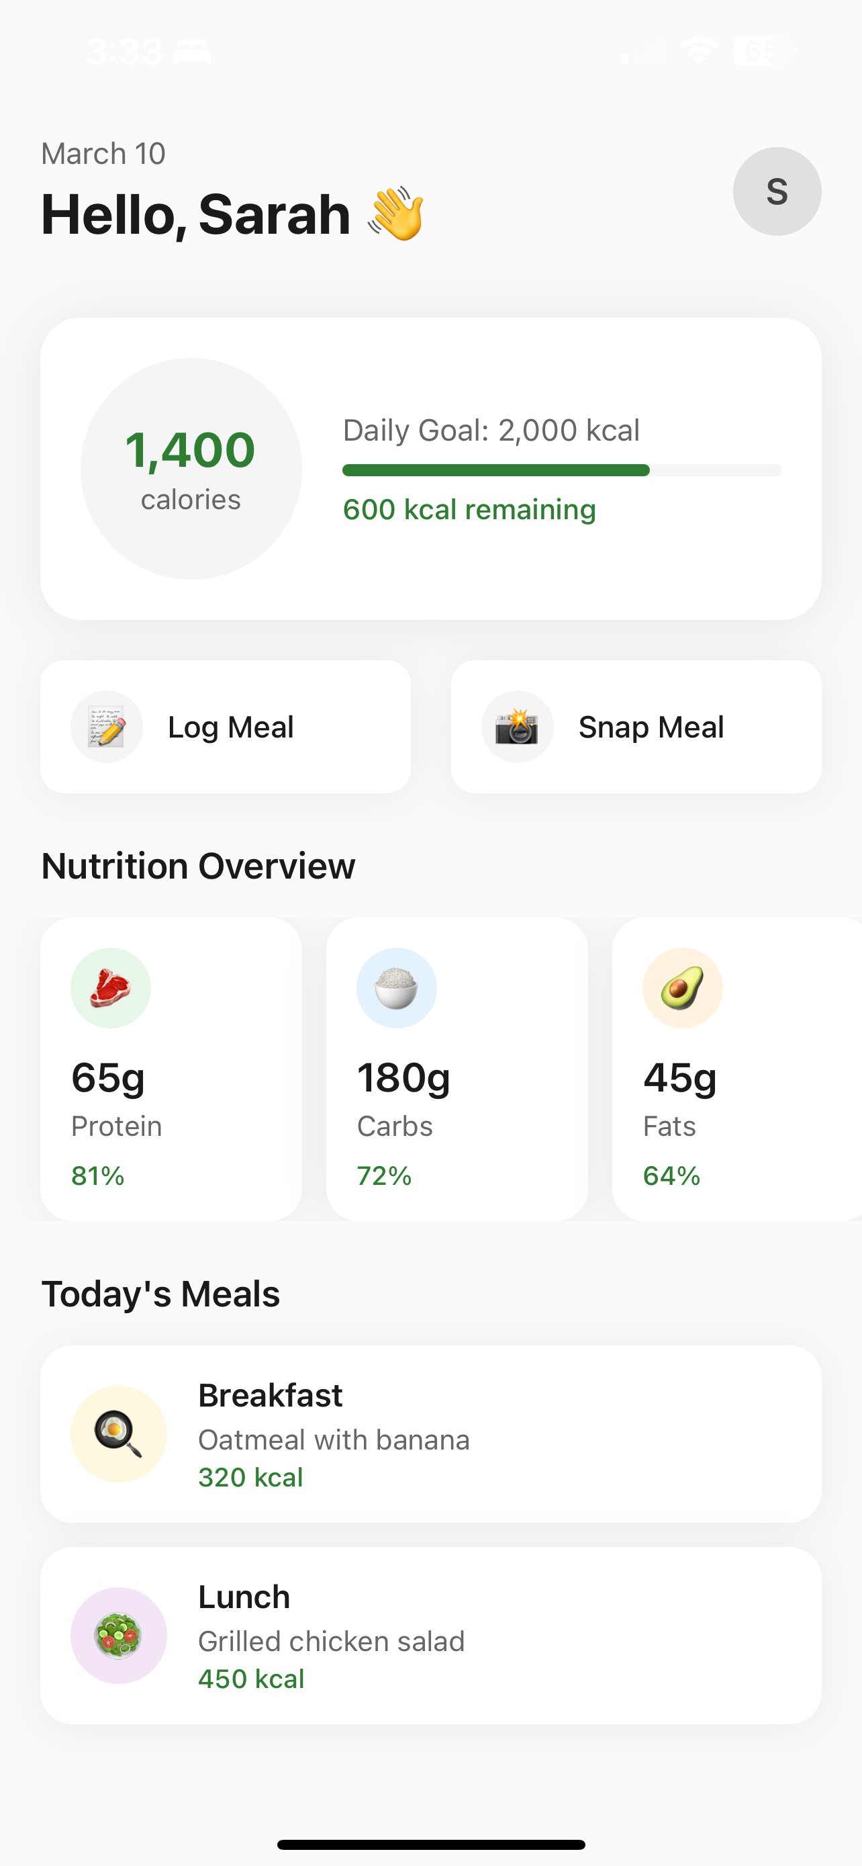
Application Screenshots

Slide 39
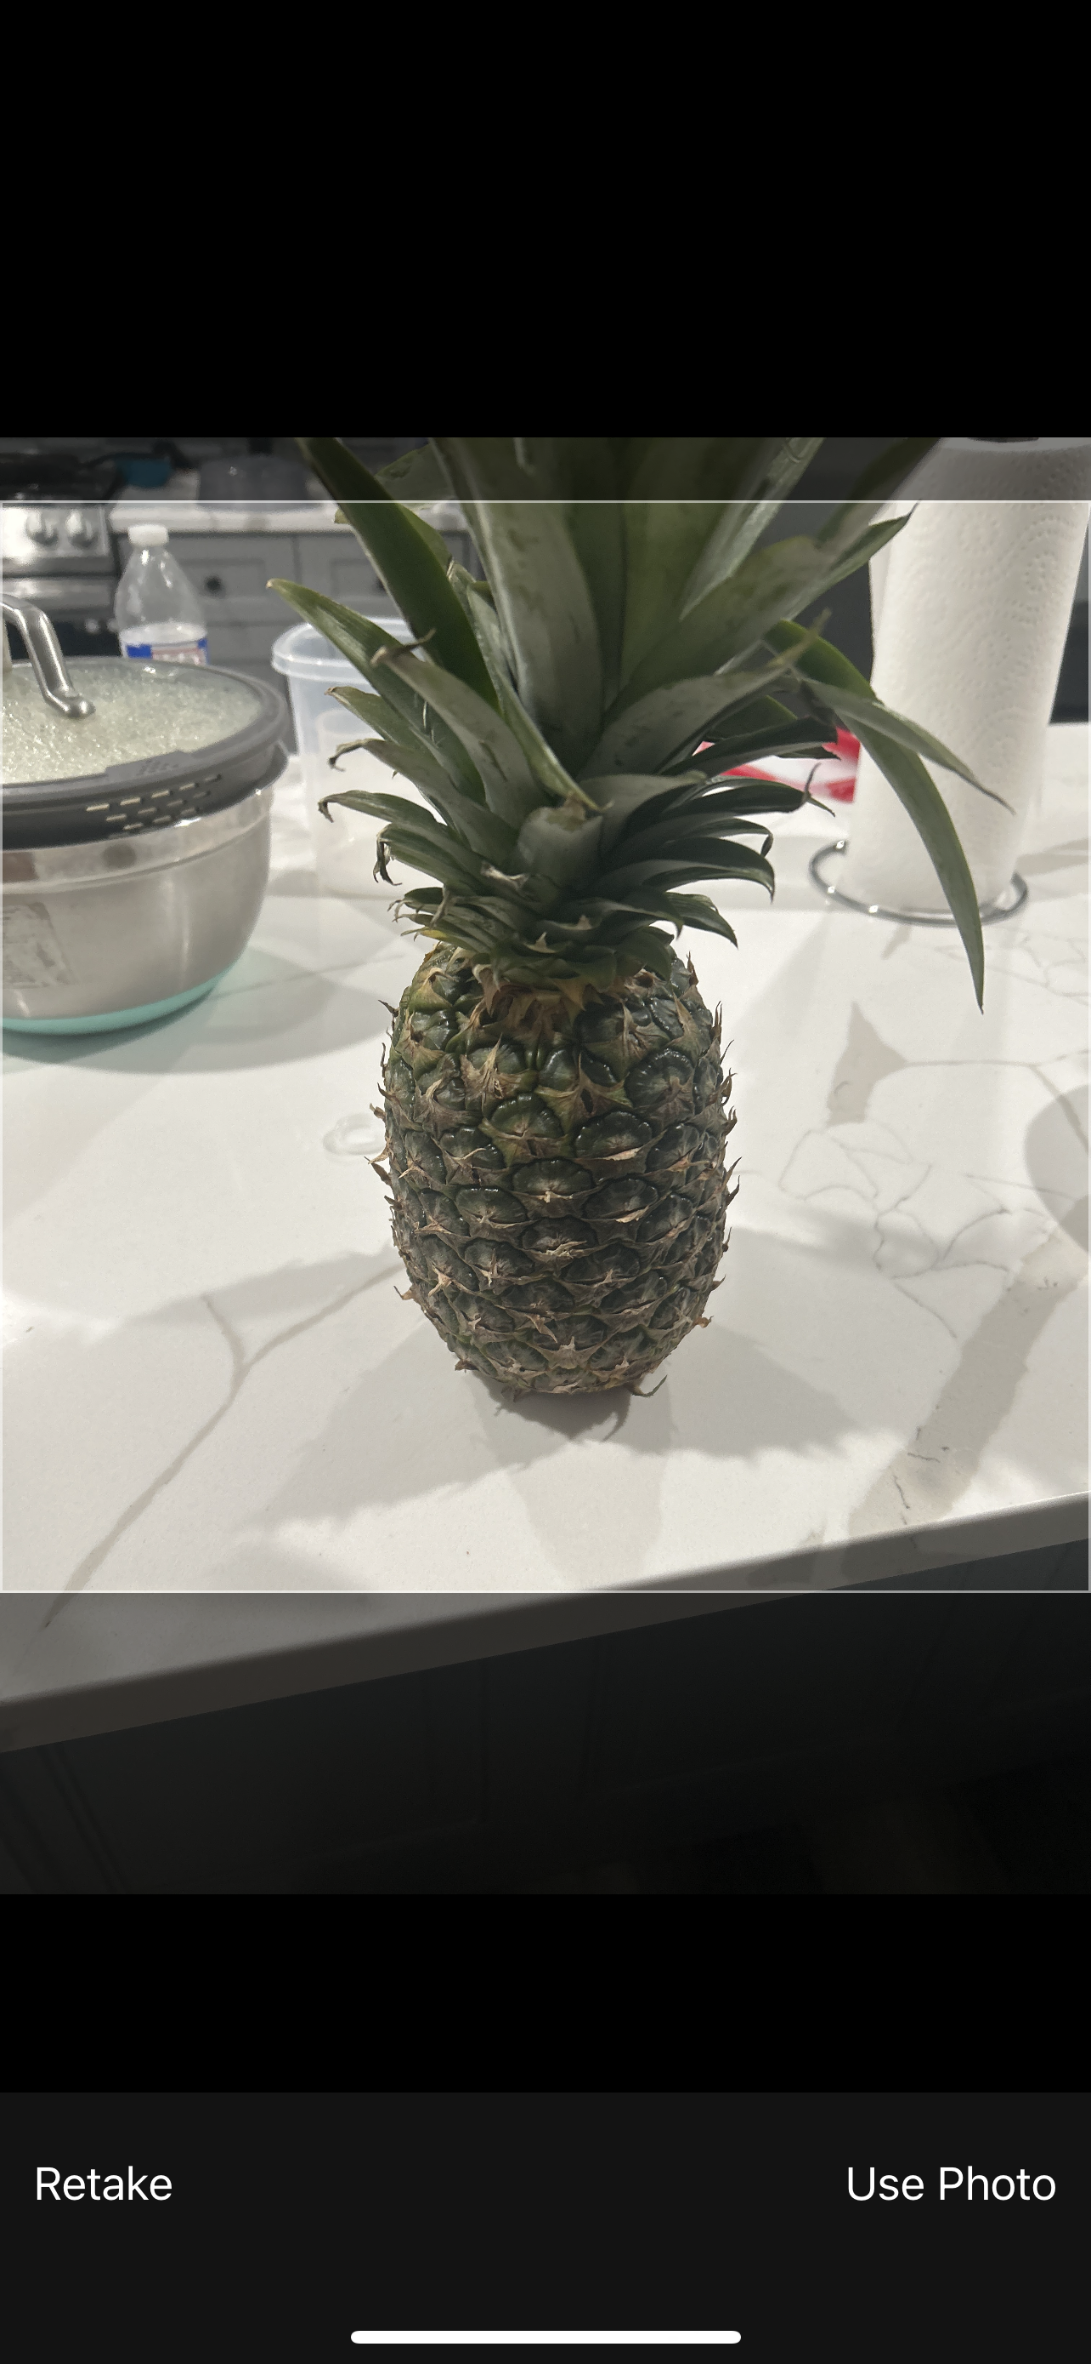
Application Screenshots

Slide 40
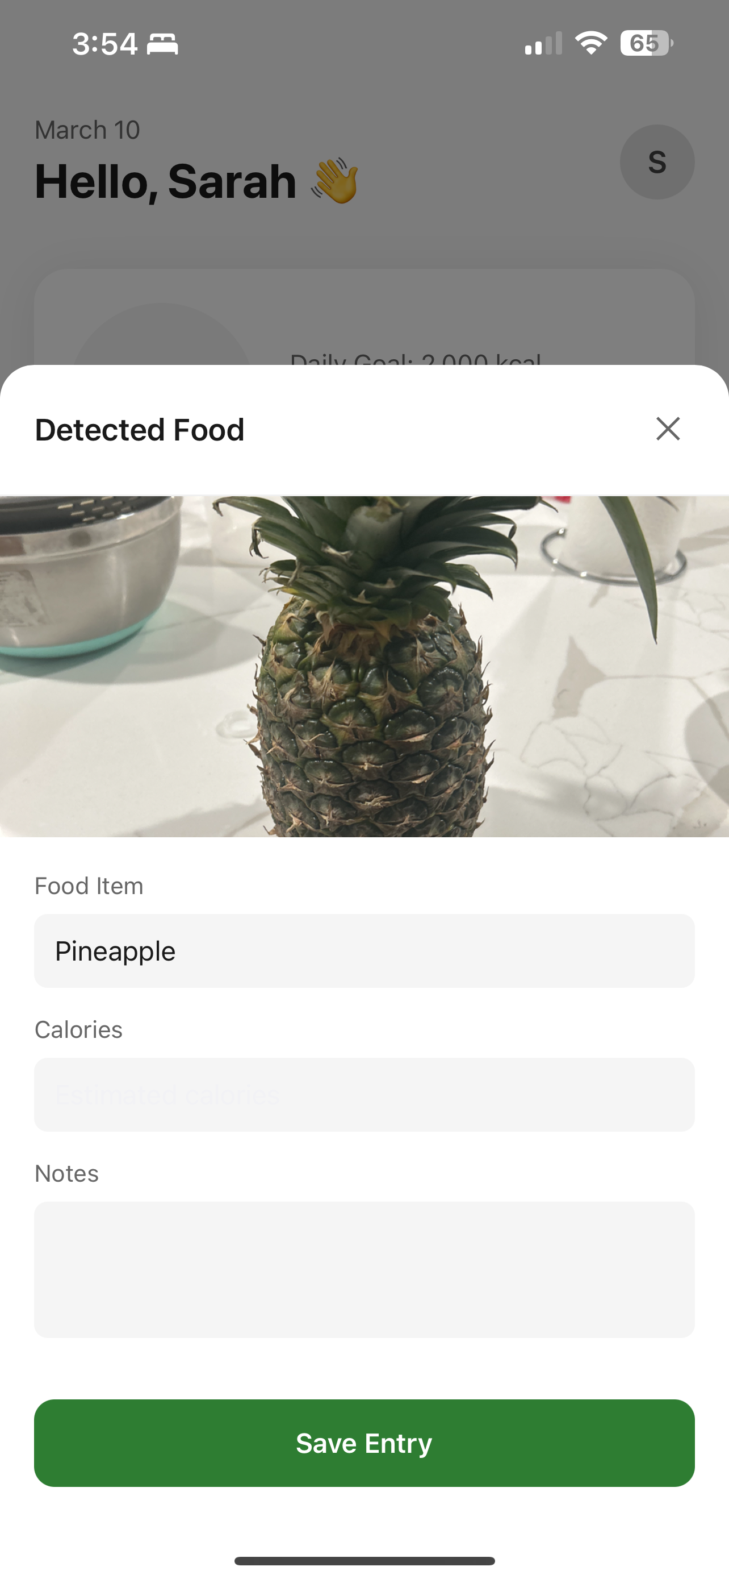
Application Screenshots

Slide 41
API
# Get all foods
$ curl http://localhost:3000/api/foods
{ "success": true, "data": [ "apple", "banana", "orange", "strawberry", "blueberry", "watermelon", "grape", "pineapple", "mango", "avocado", "carrot", "broccoli", "spinach", "potato", "tomato", "chicken breast", "salmon", "rice", "bread", "egg" ] }

Slide 42
API
# Get a specific food (apple)
$ curl http://localhost:3000/api/foods/apple
{ "success": true, "data": { "food": "apple", "calories": 52, "unit": "per 100g" } }

Slide 43
Wikipage Link
https://github.com/htmw/2025S-The-Innovators/wiki

Slide 44
Live Demo

